Slide 1


Angular
Aruna S
Department of
Computer Science and Engineering

Slide 2

angular
Angular Templates
S. Aruna
Department of Computer Science and Engineering

Slide 3
Angular
Templates
In Angular, a template is a chunk of HTML. Within a template, you can use special syntax to leverage many of Angular's features.
Each Angular template in your app is a section of HTML that you can include as a part of the page that the browser displays. An Angular HTML template renders a view, or user interface, in the browser, just like regular HTML, but with a lot more functionality.
When you generate an Angular app with the Angular CLI, the app.component.html file is the default template containing placeholder HTML.
The template syntax guides show you how you can control the UX/UI
by coordinating data between the class and the template.

Slide 4
Angular
Templates Syntax
Almost all HTML syntax is valid template syntax. However, because an Angular template is part of an overall webpage, and not the entire page, you don't need to include elements such as <html>, <body>, or <base>. You can focus exclusively on the part of the page you are developing.
To eliminate the risk of script injection attacks, Angular does not support the <script> element in templates. Angular ignores the <script> tag and outputs a warning to the browser console.

Slide 5
Angular
Templates Syntax
Interpolation—learn how to use interpolation and expressions in HTML.
Template statements—respond to events in your templates.
Binding syntax—use binding to coordinate values in your app.
Property binding—set properties of target elements or directive @Input() decorators.
Attribute, class, and style bindings—set the value of attributes, classes, and styles.
Event binding—listen for events and your HTML.
Two-way binding—share data between a class and its template.

Slide 6


Angular
Templates – Interpolation {{...}}
Interpolation allows you to incorporate calculated strings into the text between HTML element tags and within attribute assignments.
Template expressions are what you use to calculate those strings.
Interpolation refers to embedding expressions into marked up text.
By default, interpolation uses as its delimiter the double curly braces, {{ and }}.
In the following snippet, {{ currentCustomer }} is an example of interpolation.
Template Expressions:

Slide 7
Angular
Templates – Template Expressions
Template statements are methods or properties that you can use in your HTML to respond to user events. With template statements, your application can engage users through actions such as displaying dynamic content or submitting forms.
In the following example, the template statement deleteHero() appears in quotes to the right of the = symbol as in (event)="statement".
When the user clicks the Delete hero button, Angular calls the deleteHero() method in the component class.
You can use template statements with elements, components, or directives in response to events.

Slide 8
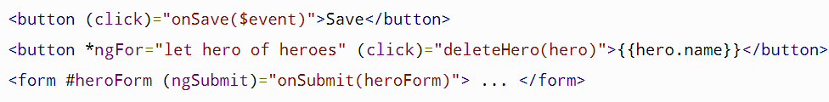
Angular
Templates – Statement Context
Template Statements have a context—a particular part of the application to which the statement belongs.
Statements can refer only to what's in the statement context, which is typically the component instance.
For example, deleteHero() of (click)="deleteHero()" is a method of the component in the following snippet.
The statement context may also refer to properties of the template's own context. In the following example, the component's event handling method, onSave() takes the template's own $event object as an argument.

Slide 9
Angular
Templates – Statement Context
On the next two lines, the deleteHero() method takes a template input variable, hero, and onSubmit() takes a template reference variable, #heroForm.
In this example, the context of the $event object, hero, and #heroForm is the template

Slide 10
Angular
Templates – Transforming Data Using Pipes
Use pipes to transform strings, currency amounts, dates, and other data for display.
Pipes are simple functions you can use in template expressions to accept an input value and return a transformed value.
Pipes are useful because you can use them throughout your application, while only declaring each pipe once.
For example, you would use a pipe to show a date as April 15, 1988 rather than the raw string format
Angular provides built-in pipes for typical data transformations, including transformations for internationalization (i18n), which use locale information to format data.

Slide 11
Angular
Templates – Transforming Data Using Pipes
The following are commonly used built-in pipes for data formatting:
DatePipe: Formats a date value according to locale rules.
UpperCasePipe: Transforms text to all upper case.
LowerCasePipe: Transforms text to all lower case.
CurrencyPipe: Transforms a number to a currency string, formatted according to locale rules.
DecimalPipe: Transforms a number into a string with a decimal point, formatted according to locale rules.
PercentPipe: Transforms a number to a percentage string, formatted according to locale rules.

Slide 12
Angular
Templates – Transforming Data Using Chained Pipes
The following are commonly used built-in pipes for data formatting:
DatePipe: Formats a date value according to locale rules.
UpperCasePipe: Transforms text to all upper case.
LowerCasePipe: Transforms text to all lower case.
CurrencyPipe: Transforms a number to a currency string, formatted according to locale rules.
DecimalPipe: Transforms a number into a string with a decimal point, formatted according to locale rules.
PercentPipe: Transforms a number to a percentage string, formatted according to locale rules.

Slide 13
Angular
Templates – Binding Syntax
Data-binding is a mechanism for coordinating what users see, specifically with application data values.
Push values to and pull values from HTML and so the application is easier to write, read, and maintain if you turn these tasks over to a binding framework.
Declare bindings between binding sources, target HTML elements, and the framework do the rest.
Angular provides many kinds of data-binding. Binding types can be grouped into three categories distinguished by the direction of data flow:
From the source-to-view
From view-to-source
Two-way sequence: view-to-source-to-view

Slide 14
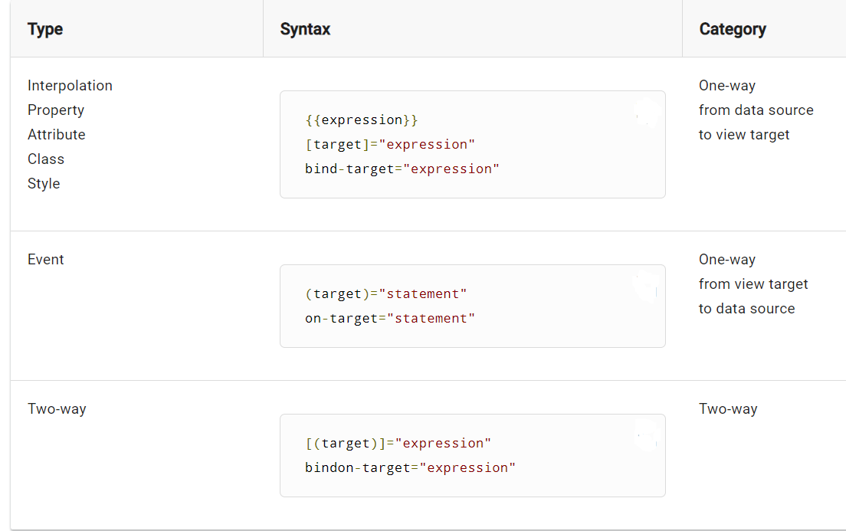
Angular
Templates – Binding Syntax

Slide 15
Angular
Templates – Binding Syntax
Binding types other than interpolation have a target name to the left of the equal sign, either surrounded by punctuation, [] or (), or preceded by a prefix: bind-, on-, bindon-.
The target of a binding is the property or event inside the binding punctuation: [], () or [()].

Slide 16
THANK YOU
Aruna S
Department of
Computer Science and Engineering
arunas@pes.edu

